Slide 1
Student Case Study
Katie Rzepka
EDI 310
Fall 2020

Slide 2
Participant information
Academic Strengths: After reading the observations of Nicki, it is evident that she is a helpful student who can be responsible/trusted student in the classroom. Nicki also is listed as a very smart student. Lastly, Nicki seems to make friends easily and is liked by her peers.
Areas of Need:
Increase level of respect towards cooperation and adults.
Increase the frequency of positive interactions with school staff and peers.
Increase positive behavior decisions in the classroom and confidence in the student that they can make good decisions in the classroom.
Name: Nicki
Age: 9 years old
Grade: 3rd grade
Gender: Female
Race: African-American
Home Life: Nicki currently lives at home with her father and grandmother. She has three siblings, a brother and two sisters, who live with other relatives. Her mother is currently serving a 7-year prison sentence for drug related issues.

Slide 3
Classroom context
Other Classroom Information:
The classroom is made up of 24 students, 10 boys and 14 girls.
The elementary school is a Title-1 School.
6 students have a 504 Plan (ADHD), 4 students with IEPS, and 12 English Language Learners.
The teacher has 8 years of experience.
Uses Class Dojo, Clip Charts, and “Bengal Bucks” as part of her classroom management system. She also allows for flexible seating, though her students do have assigned seats for the Literacy and Math Block.
Daily Routine:
8:00-8:15 – Breakfast
8:15-8:30 – Morning Circle
8:30-10:30 – Literacy Block
10:30-10:45 – Recess
10:45-11:45 - Special
11:45-12:15: Lunch
12:15-2:15: Math
2:15-3:00 - Science/Social Studies
3:00-3:10 – Clean Up/ End of Day

Slide 4
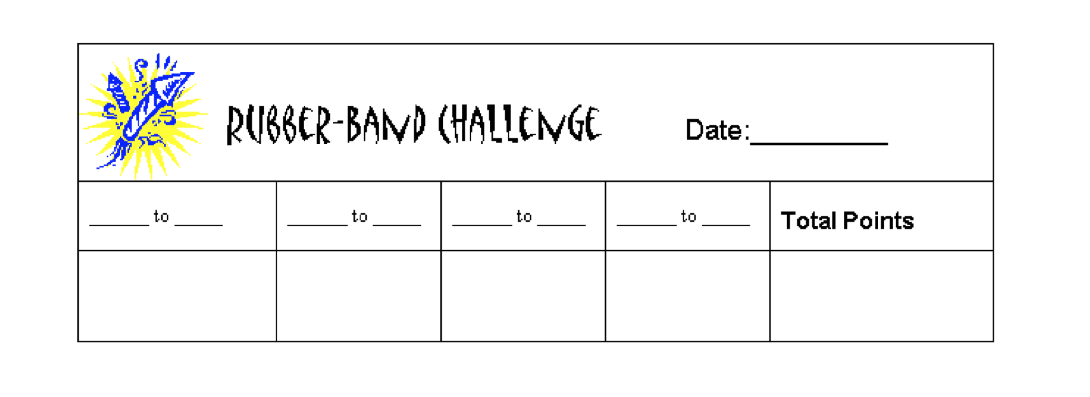
Strategy reccomendation#1 :
Rubber-Band Challange

Slide 5
Strategy recommendation #1 : Rubber-Band challenge
Summary
For this strategy, Nicki would be given six rubber-bands to put around her wrists every half hour. Each time she is reminded about her behavior (not returning to her seat, not following directions, talking out of turn), the student will transfer one rubber-band to their other wrist. At the end of the half-hour, the number of rubber-bands on the original wrist. If the student has at least one rubber band remining on the original wrist, they earn a “+”. For each “+” the student earns, they get a point. The student then can cash in their points for a reward that was created by the instructor. Gradually, you will release the number of rubber-bands the student begins with at the beginning of the half hour, until they only have 1-2. After this, the strategy can be discontinued.
Analysis
I believe this will be an effective strategy for Nicki. This allows the teacher to make a quick check on her behavior, while also allowing Nicki to see how she is doing throughout the day. This will also allow for her to still makes some behavior mistakes in the beginning, while still be rewarded for her good behavior. From a teacher perspective, this can build a healthy student/teacher relationship. Overall, this strategy implements a great gradual release model that is achievable by this student.

Slide 6
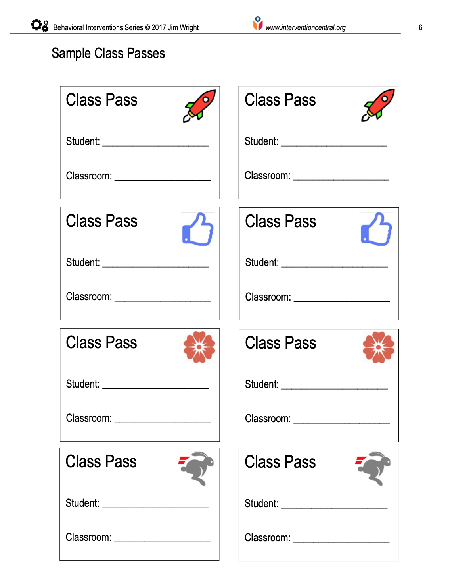
Strategy reccomendation#2 :
Class Pass

Slide 7
Strategy recommendation #2
Summary
The strategy “Class Pass” is helpful for disruptive classroom behaviors. The teacher allots a certain number of class passes per day that the student can use. The student can use a pass by signaling to the teacher using a method that was discussed between this student and the teacher. When on a break, the student will give one of their passes to the teacher and can move to the set “break” location within the school. While on the break, the student will have a timer set and will return to instructional time when the timer runs out. At the end of the day, the teacher will check in with the student on the number of passes they still have remining. If the student has left over passes, they can choose from the “reward menu” that is also used in the rubber-band activity. To promote increased work tolerance, however, the student is also given an incentive to retain passes unused to redeem later for rewards.
Analysis
I believe this strategy will be helpful for this student. Being this student comes from trauma, this pass allows them to take a break when they are feeling overwhelmed in the classroom. This also allows for less disruptions in the general classroom. The teacher will “train” this student on the class passes by going over clear expectations, modeling the use of the pass, and inform the student when these breaks are not permitted. The student receives a certain number of passes, approved break activates, length of break time and a reward menu. This strategy can build student reasonability, teacher/student relationship, and accountability. The number of passes can be discontinued as behavior improves.

Slide 8
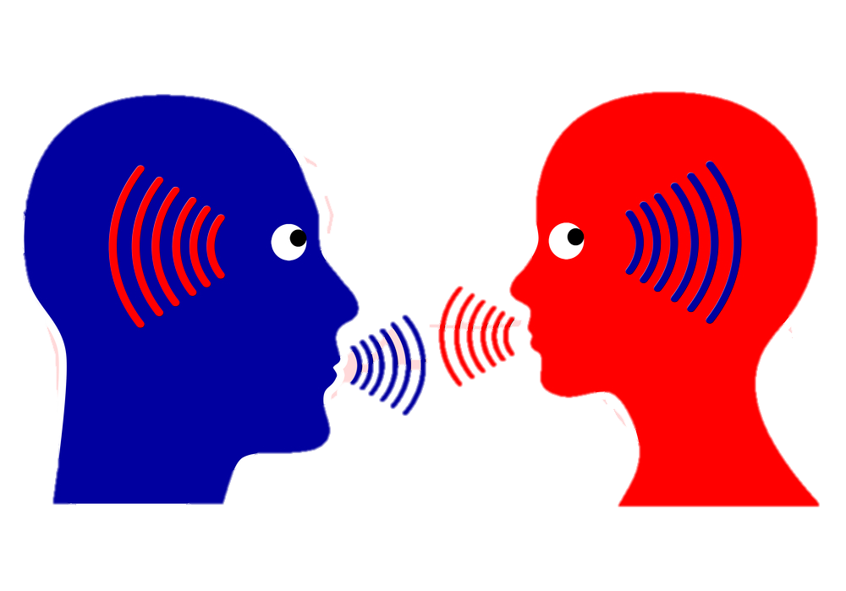
Strategy reccomendation#3 :
Active Listening

Slide 9
Strategy recommendation #3
Analysis
I believe this strategy will be helpful in creating a positive relationship between Nicki and her teacher. One of the most important ways to manage a defiant student is to have a strong relationship with that student. If the teacher and student are constantly in a power struggle, the behavior may worsen, and the entire classroom could become off task. For Nicki, this could show her that adults in power are not to fear or become frustrated by but want the best for them in the classroom. Nicki will feel heard when she is having a behavior issue instead of being shut down by the teacher. Note, though, that active listening does not imply that you necessarily agree with the student's point of view. Rather, it shows that you fully comprehend that viewpoint. Students tend to view teachers who practice active listening as being empathic, respectful, and caring individuals.

Slide 10
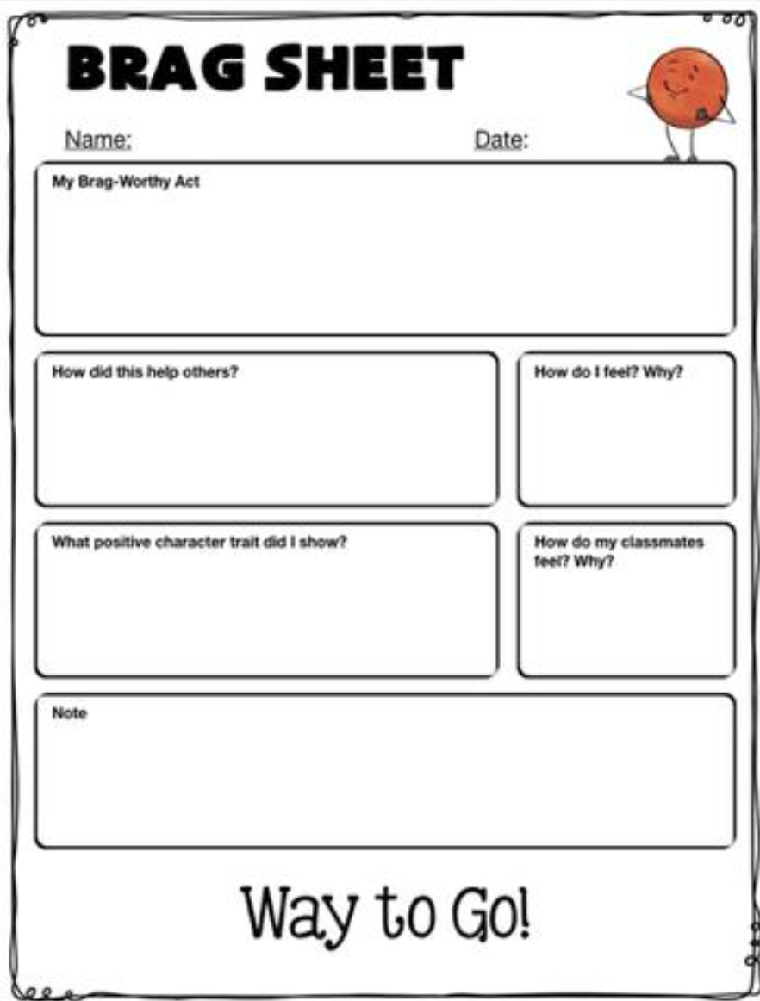
Strategy reccomendation#4 :
Brag Sheet

Slide 11
Strategy recommendation #4
Summary
The strategy “Brag Sheet” allows the teacher to reinforce positive behavior. This strategy also allows the student to document their good behavior throughout the day and take time to reflect on how that behavior impacts those around her. This sheet has the student feel in…
The “brag-worthy act”
How the act helped others
The positive character trait they showed
How they felt and why
How their classmates felt and why
Analysis
I believe Nicki will benefit from this greatly. Instead of interactions between Nicki and her teacher being negative, this reinforces the positive behavior that Nicki is showing. Nicki then has a chance to reflect on how she felt after the behavior and how it impacted those around her. Eventually, the hope is that Nicki will want to show positive behavior because she can see on paper the outcomes of her behavior. The teacher may also use a sheet where the student reflects on some negative behavior to see the contrast in how she feels after the fact. These sheets can even be used at home with parents/guardians to keep the consistency.

Slide 12
Conclusions
For my future classroom…
The most important component to an effective classroom is based on the relationships you develop with your students. Within the first few weeks of school, my focus will be on these relationships. That means that the use of scare tactics will not be used inside my classroom.
When working with students that are labeled as the “troubled students”, it is important to try and change the narrative for the student. If the student believes they are a troubled child, they will live up to that label. Positive behavior that is reinforced in the classroom will allow for the student to view themselves in a positive manner.
Do not take students behavior personally. We must understand that student behavior is not a direct result the teacher but can be improved by how the teacher approaches the situation. Each student is fighting their own battels in life and often need tools to mange these emotions.

Slide 13
Recommendations
For students like Nicki, I recommend the following…
Acknowledge their feelings of anger and frustration as quickly as you can. Although the behavior is not acceptable, students need for you to understand the reasons for the outburst. The student must feel like they are valued in the classroom.
Many problems with defiant students can be prevented with early action. To do this, keep a close eye on the student has they enter the room and throughout the entire day. If you notice that the student is frustrated or upset, be there to support the student.
Continue to work on your relationship with the student. A positive relationship with the student can go far in preventing any defiant behavior. It is up to the teacher to make sure that this relationship remains positive with all students of your classroom, regardless of the student's behavior. Each student in the classroom must be treated fairly – no matter what.

Slide 14
References
Driscoll, L. (2020, January 22). Classroom Strategies for Defiant Behavior. Retrieved November 18, 2020, from https://www.socialemotionalworkshop.com/2018/10/defiant-behavior-strategies/
Collins, T. (n.d.). Response To Intervention – RTI Resources. Retrieved November 18, 2020, from https://www.interventioncentral.org/
Thompson, J. G. (2018). First-Year Teacher's Survival Guide: Ready-To-Use Strategies, Tools and Activities for Meeting the Challenges of Each School Day. Wiley & Sons, Incorporated, John.

